Slide 1
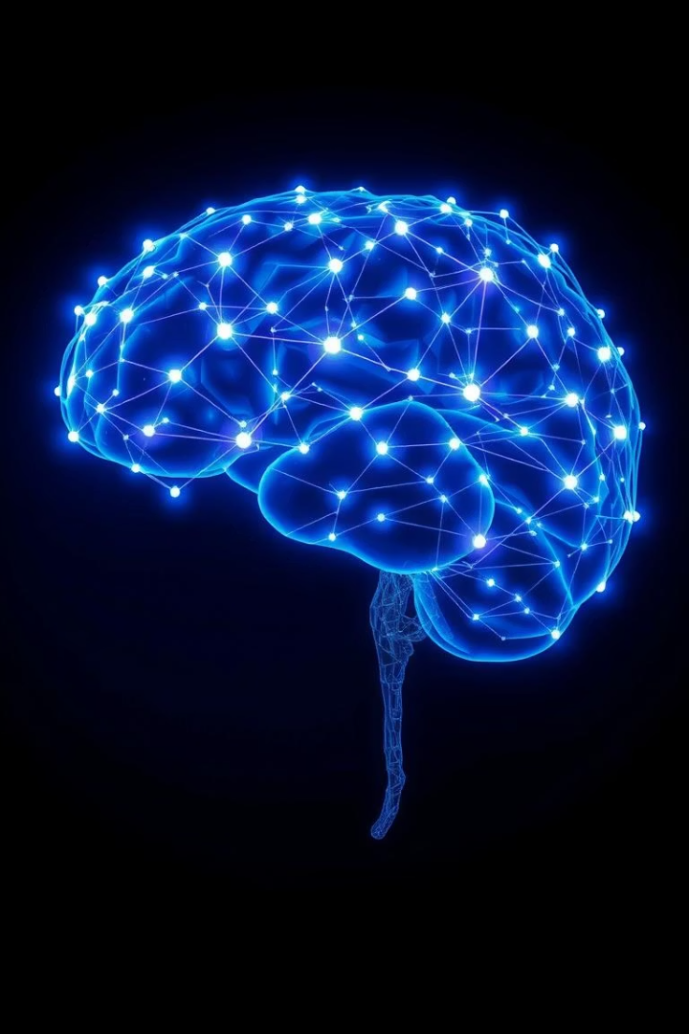
Artificial Intelligence and Knowledge Representation: Understanding Intelligent Behavior in Machines
Artificial Intelligence (AI) has transformed from an abstract idea into a powerful technology embedded in devices today, from voice assistants to healthcare diagnostics. At its core lies the question of how machines can simulate intelligent human behavior.
One key approach is through Knowledge Representation (KR), which enables machines to store, organize, and apply knowledge in ways that mimic human reasoning. This presentation explores the foundations and significance of KR within AI systems.

Slide 2

What is Knowledge Representation (KR)?
Definition
Key Features
KR encodes world information to enable machines to solve complex problems beyond simple data storage.
Efficient knowledge storage
Accurate retrieval of relevant data
Logical reasoning for conclusions
Ability to learn and update knowledge
Unlike typical databases, KR involves capturing relationships and logic rules essential for decision-making. It serves as the backbone for intelligent functionalities in AI.

Slide 3
Forms of Knowledge Representation
Semantic Networks
Frames
Production Rules
Logic & Ontologies
Graphs with concepts as nodes and relationships as edges. Example: Robin → is-a → Bird.
Structured data representing typical scenarios with slots and values.
“If-Then” rules used in expert systems to derive conclusions from conditions.
Formal mathematical statements and hierarchical definitions of concepts and relationships used in advanced reasoning and semantic web.
Each model supports different aspects of knowledge processing, enabling AI to interpret and infer information effectively.

Slide 4
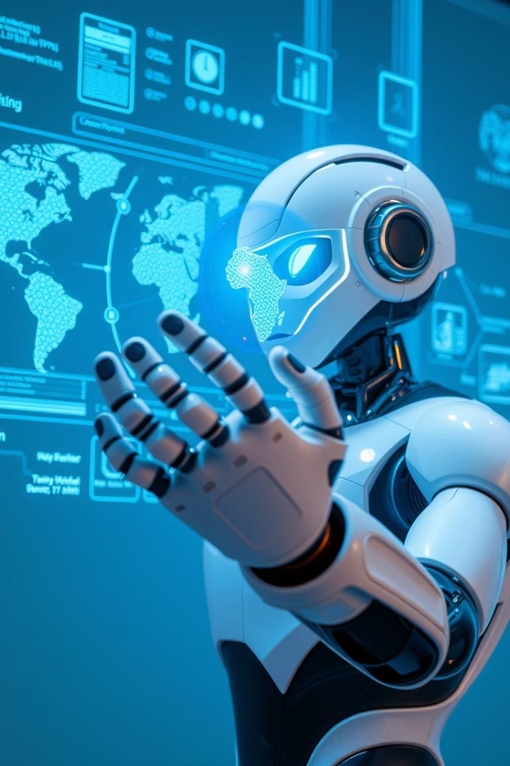

Why is Knowledge Representation Important?
Expert Systems
Natural Language Processing
Robotics & Planning
Enable precise decision-making in medicine and chemistry with systems like MYCIN and DENDRAL.
Knowledge models help robots reason, navigate, and adapt to dynamic environments.
Structured knowledge aids understanding and generating human language accurately.
Learning & Adaptation
AI uses KR to integrate new experience and refine knowledge continuously.

Slide 5

Challenges in Knowledge Representation
Ambiguity
Human language is often vague and imprecise, complicating machine interpretation.
Incomplete or Uncertain Information
Real-world data can be partial or noisy, requiring robust reasoning methods.
Scalability
Large knowledge bases challenge consistency maintenance and computational efficiency.
Contextual Understanding
Machines struggle to grasp context and subtle nuances critical to true understanding.
Addressing these challenges is vital for advancing AI systems that can operate reliably in complex, real-world situations.

Slide 6

Conclusion
Learning
Reasoning
Continuous adaptation through knowledge update is key to intelligent behavior.
Understanding
Logical frameworks enable machines to make informed decisions.
AI needs rich knowledge models to grasp the complexities of the world.
Knowledge Representation forms the foundation for these capabilities, shaping the path toward smarter, more human-like AI systems. Designing flexible, expressive knowledge models remains a central pursuit in AI research and development.

